Slide 1
Tutorial 5 CSI3130-Database II
Vikas Gogia (vgogi074@uottawa.ca)

Slide 2
17.8
The lost update anomaly is said to occur if a transaction T_{j} reads a data item, then another transaction T_{k} writes the data item (possibly based on a previous read), after which T_{j} writes the data item. The update performed by T_{k} has been lost, since the update done by T_{j} ignored the value written by T_{k}.
a. Give an example of a schedule showing the lost update anomaly.
b. Give an example schedule to show that the lost update anomaly is possible with the read committed isolation level.
c. Explain why the lost update anomaly is not possible with the repeatable read isolation level.

Slide 3
(c) Repeatable Read Isolation Level: When T1 holds a shared lock on data item D till its execution termination.
Lost Update doesn’t occur in repeatable read isolation as T2 can’t obtain an exclusive lock for making a blind write on data item D until T1 finishes. In essence, serialization order is preserved i.e. T1 → T2 and thus update by T1 on D isn’t lost.

Slide 4
17.19
Explain why the read-committed isolation level ensures that schedules are cascade-free.

Slide 5
What’s a cascade-less or cascade-free schedules? - The schedules which don’t consist of cascading rollbacks that make it irrecoverable.
Read committed isolation level: ensures a transaction reads only committed data.
Let’s take a scenario where T1 and T2 are 2 transactions operating on a data item D. T2 has modified D, but yet uncommitted. Here, when T1 tries to read D before T2 committing it, it’s called a dirty read. And, as we know, dirty reads cause cascading.
But, conversely, in case of read committed isolation level, T1 can’t read D until it’s not committed by D. It implies that if there’s no dirty read, the schedule must be cascadeless.

Slide 6
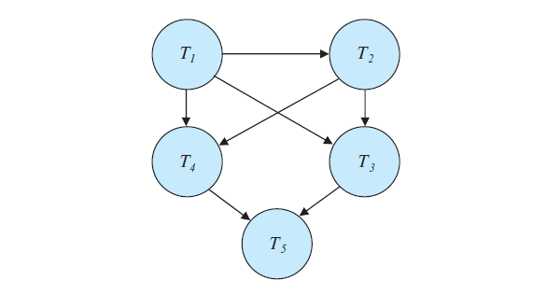
17.6
Consider the precedence graph of Figure 17.16. Is the corresponding schedule conflict serializable? Explain your answer.

Slide 7
Since there’s no loop inside the precedence graph i.e. it’s acyclic. It can be inferred that the schedule is conflict serializable.

